Slide 1

Resume
Classification
Group Members :
Ms. Bhanupriya K.
Mr. Anush Goel
Mr. Harsha Krishna Malisetty
Mr. Geddam Nikhilreddy
Mr. Sajneev Mishra
Mr. Shubham Rangari

Slide 2
Resume Classification
The aim of this project is to significantly reduce manual human effort in the HRM (Human Resource Management) process

Slide 3
TABLE OF CONTENTS
01
04
About the Project
Model Evaluation
EDA & Visualization
02
05
Deployment
Model Building
03
06
Conclusion
Resume Classification
Present the evaluation metrics used to assess the performance of the model.
Data Structure, Data Dimension, Data Types, Checking Missing Values.
pie chart, bar chart, Count Plot, Histogram ,Scatter plot, Tree Map.
The solution will integrate into the existing HRM system
Naive Bayes
Support Vector Machine
Logistic Regression
Random Forest
Gradient Boosting
AdaBoost
Bagging Classifier
Decision Tree
KNN Classifier
The benefits of the automated resume classification solution

Slide 4

Resume Classification
Resumes
What is resume classification?
Resume classification is the process of automatically assigning a resume to a specific category or class. This can be done based on the resume's content, such as the job title, skills, and experience, or it can be done based on the resume's format, such as functional or chronological.
Why is it important?
it can help to automate the job search process. By automatically classifying resumes, employers can quickly and easily identify candidates who are a good fit for their open positions.
Resume classification can help to improve the accuracy of applicant tracking systems (ATS). ATS are software programs that are used to scan resumes and match them to job openings.
Resume classification can help to improve talent management. By tracking the skills and
experience of their employees, employers can better understand their workforce and make more informed decisions about hiring, training, and promotions

Slide 5
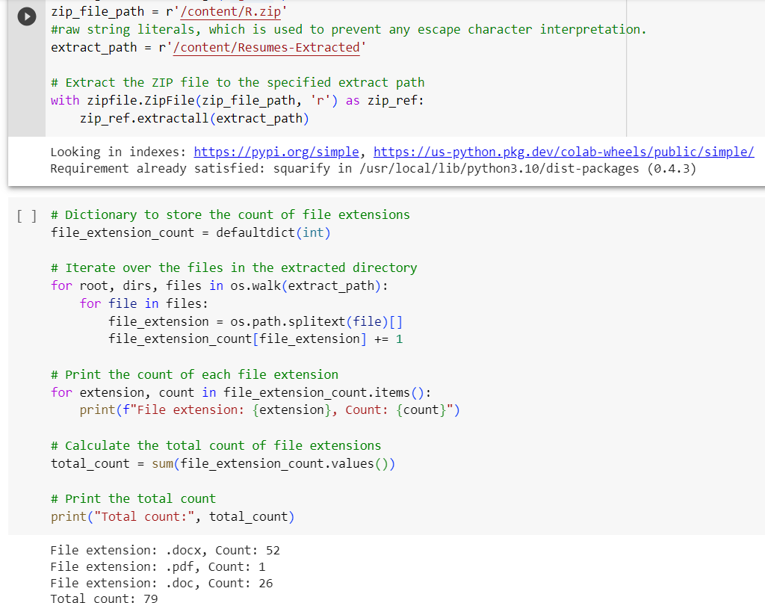
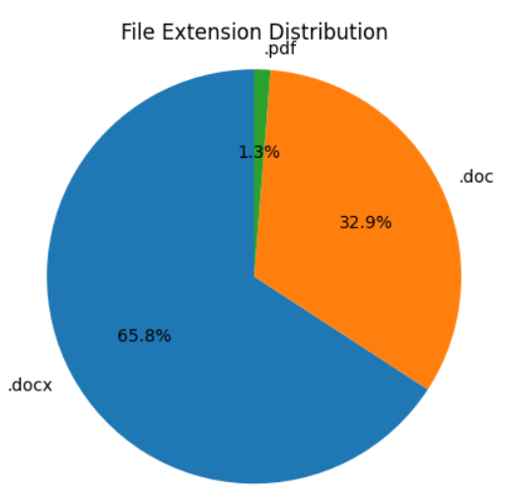
Unzipping File (Process)

Slide 6
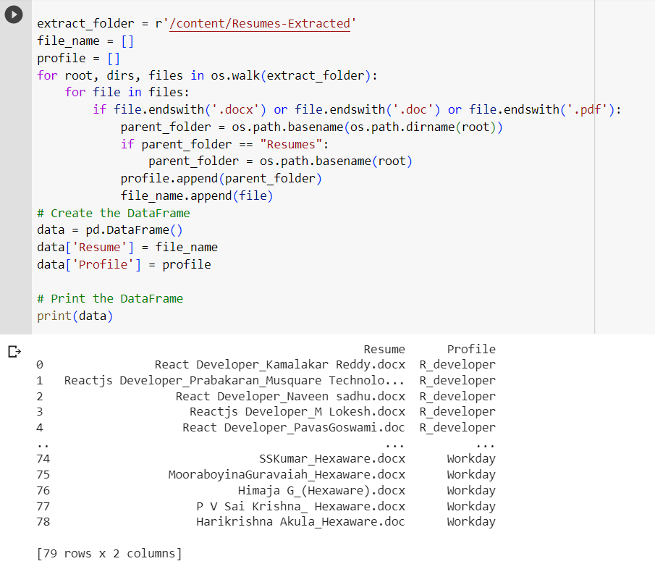
Merging all category files.

Slide 7
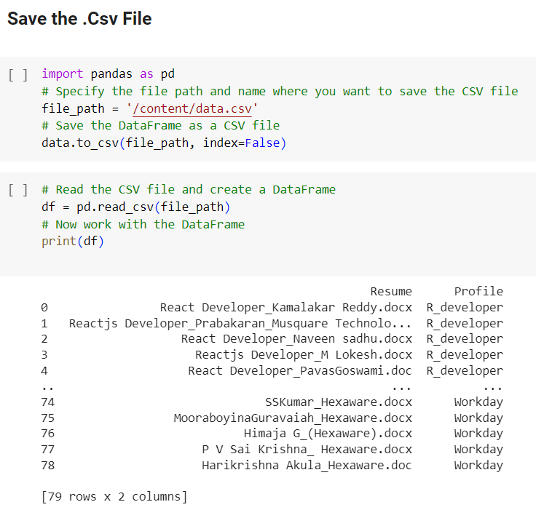
Converting text to .csv (Process)

Slide 8
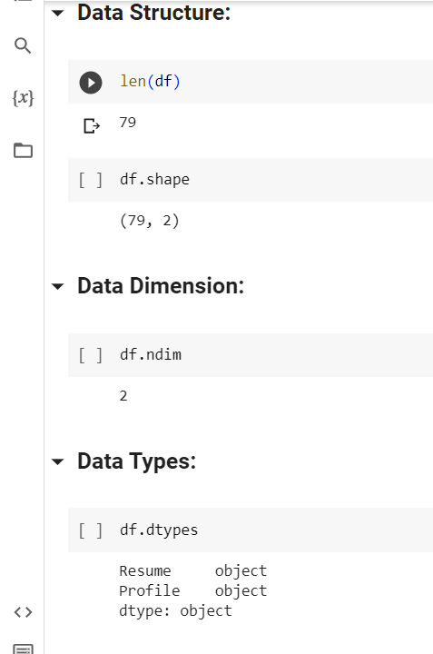
Data Set Details
After Extracting and Modifying the Dataset, given data contains a total of 2 Classes and 79 rows .

Slide 9
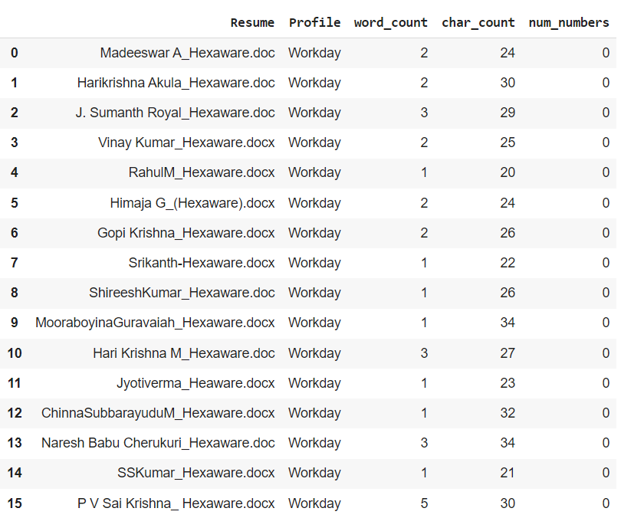
EDA

Slide 10
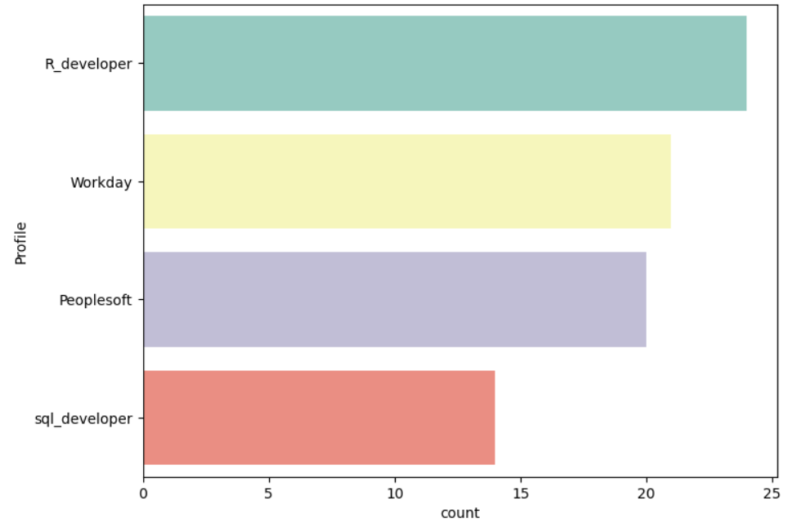
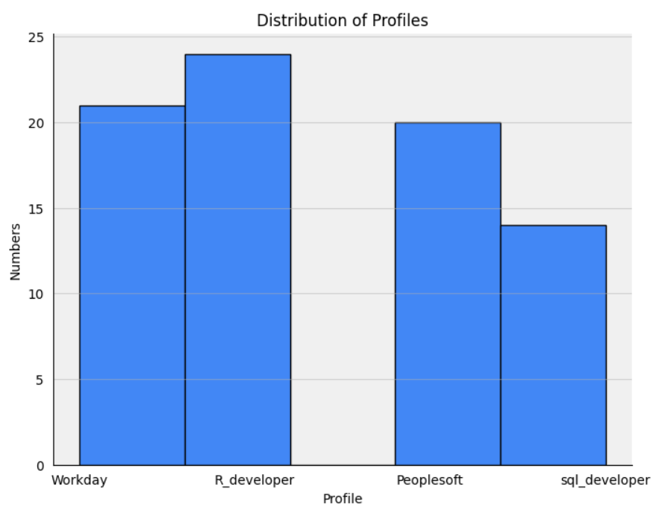
Visualization
Count Plot:
Histogram:

Slide 11
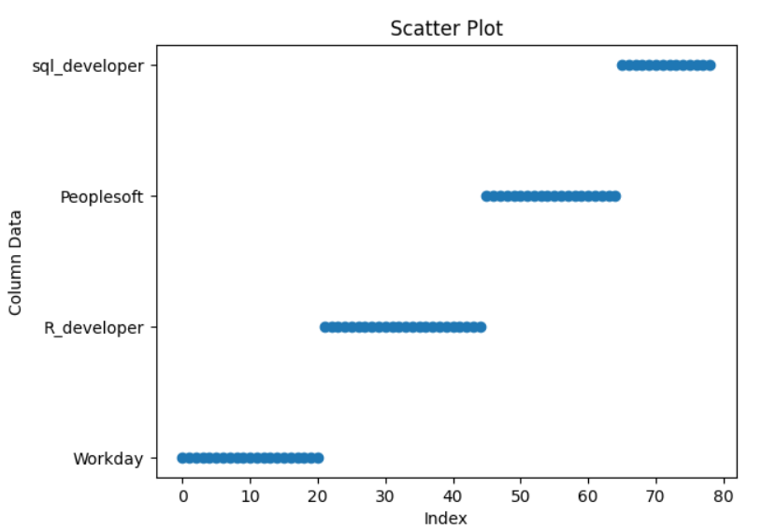
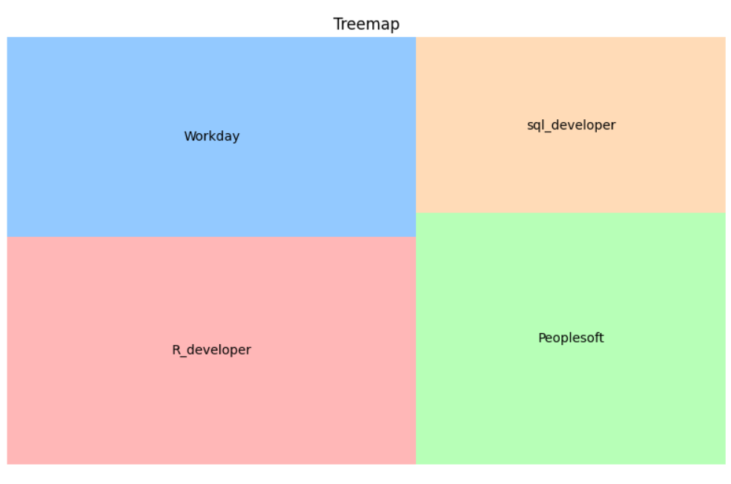
Visualization
Scatter plot:
Tree Map:

Slide 12
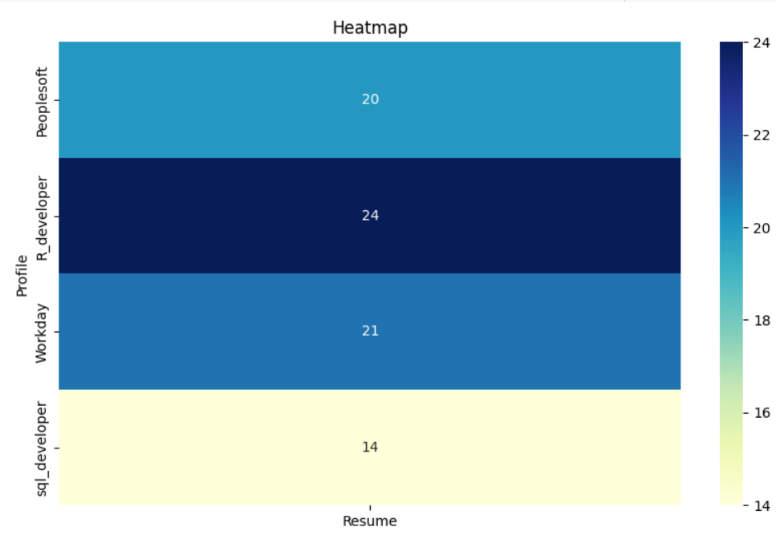
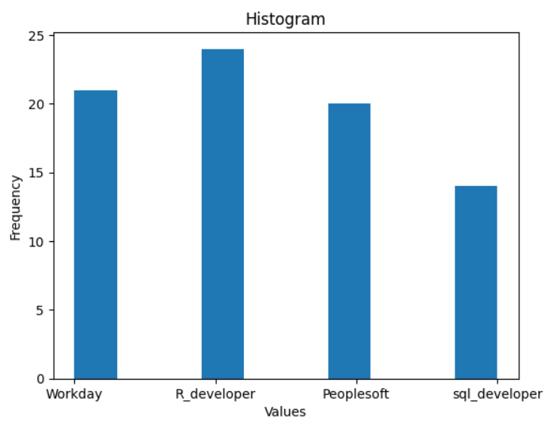
Visualization
Heat Map:
Histogram:

Slide 13
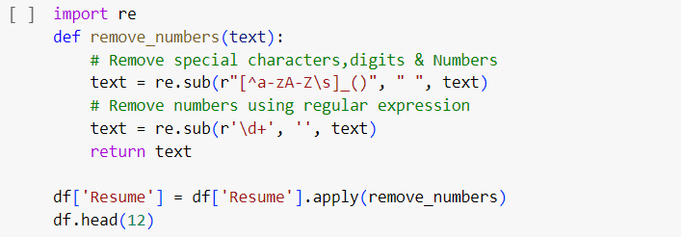
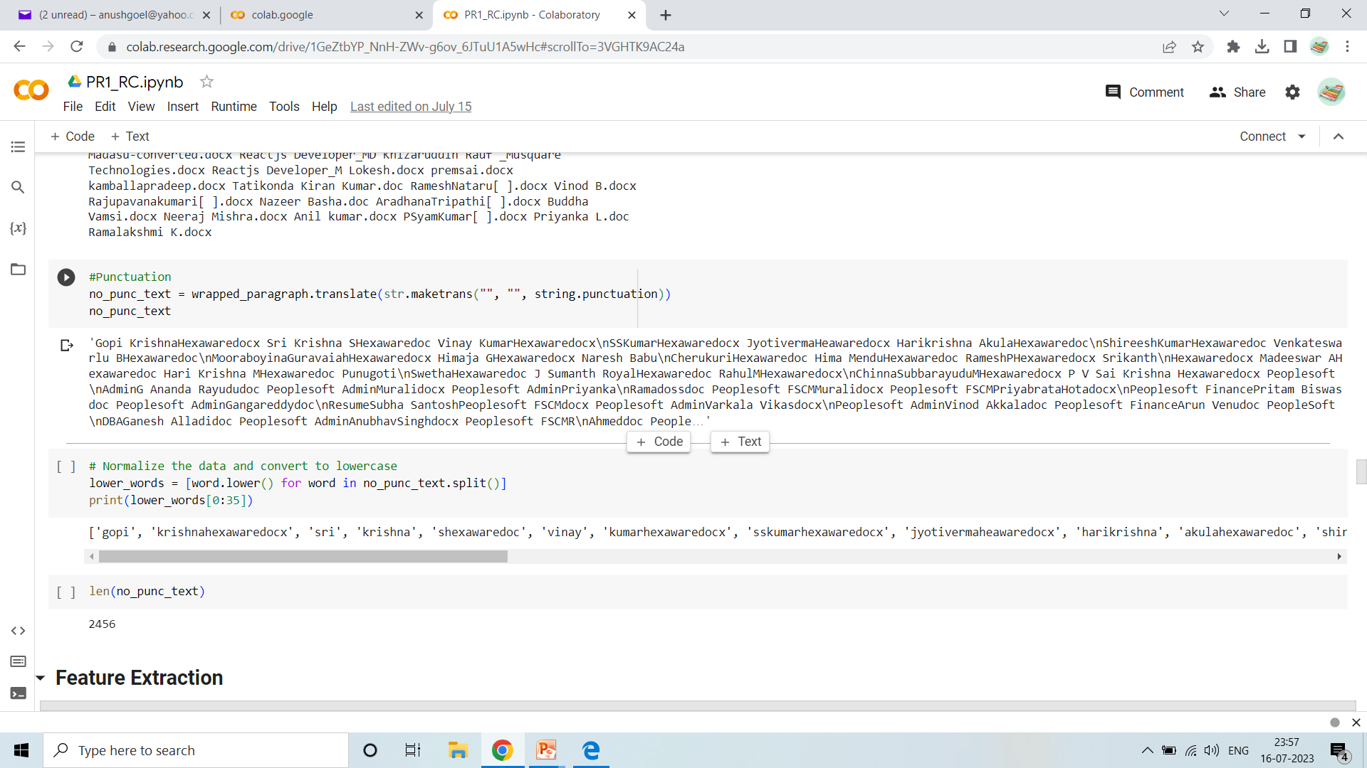
Text – Preprocessing
Removing All Unwanted Character’s
Unwanted Character’s like - \n \t, http links, tags, hashtags, html tags, converting to lower case, removing white spaces etc.
Lower text and remove punctuation

Slide 14
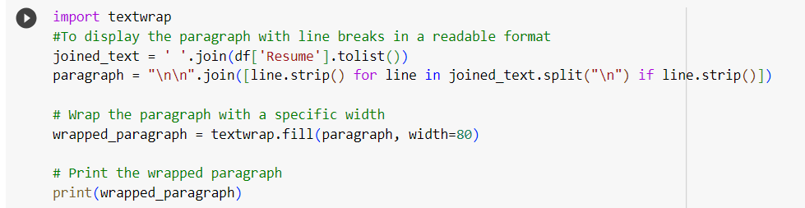
Text – Preprocessing
TEXTWRAP
Used for normalize whitespace, remove or add indentations, prefix and suffix text, and a myriad of other uses

Slide 15
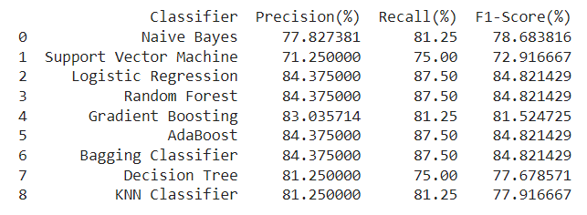
Model Building

Slide 16
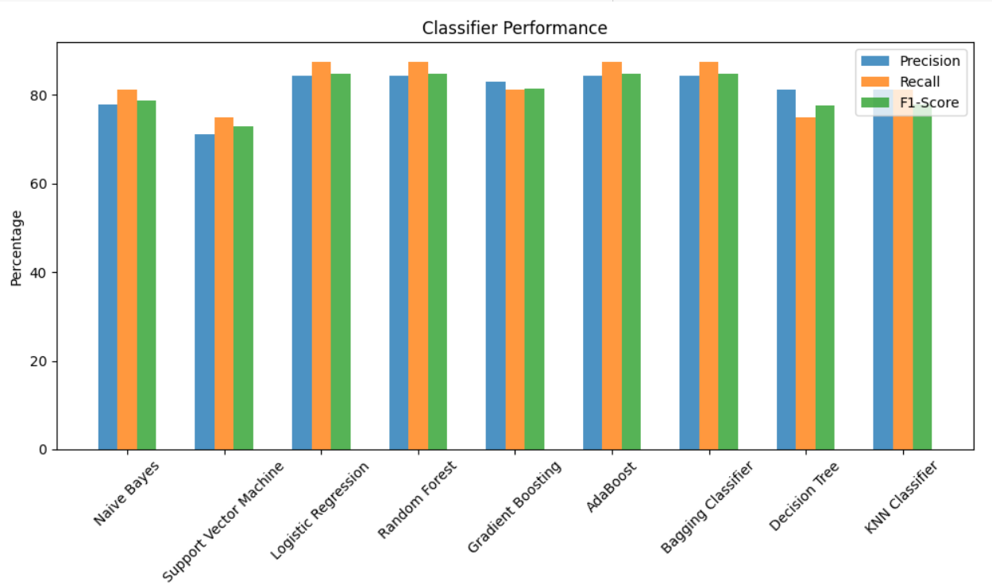

Slide 17
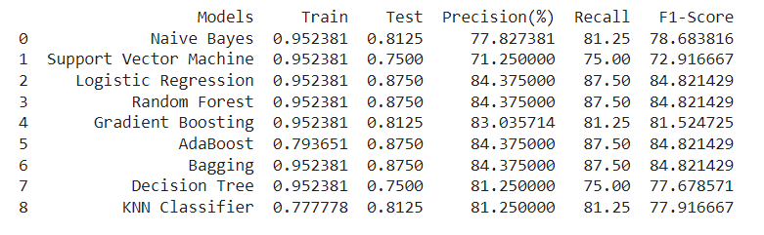
Model Evaluation

Slide 18
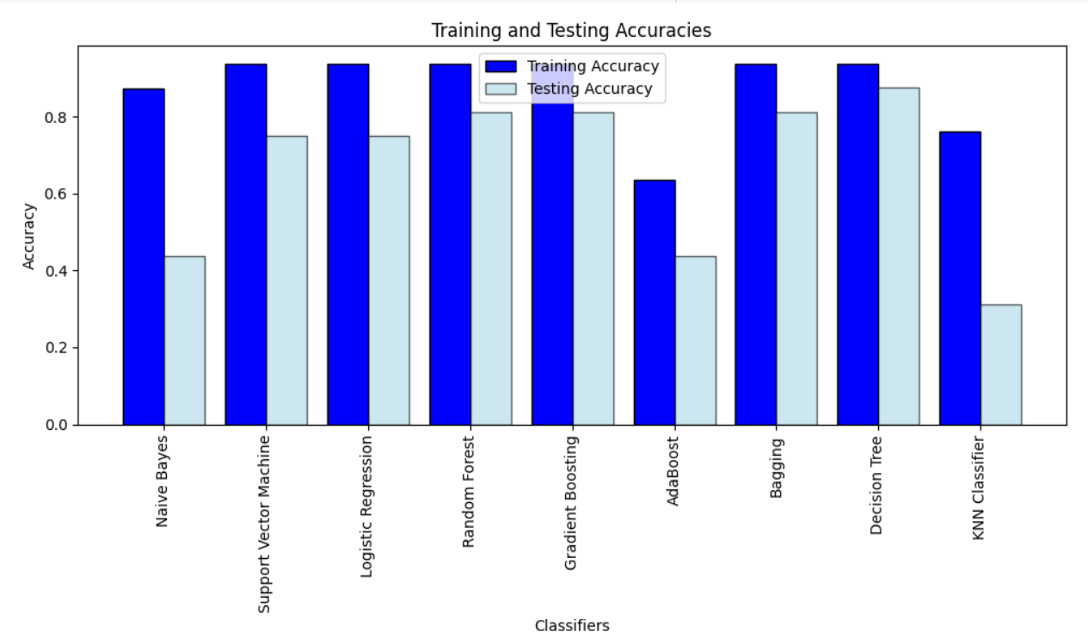

Slide 19
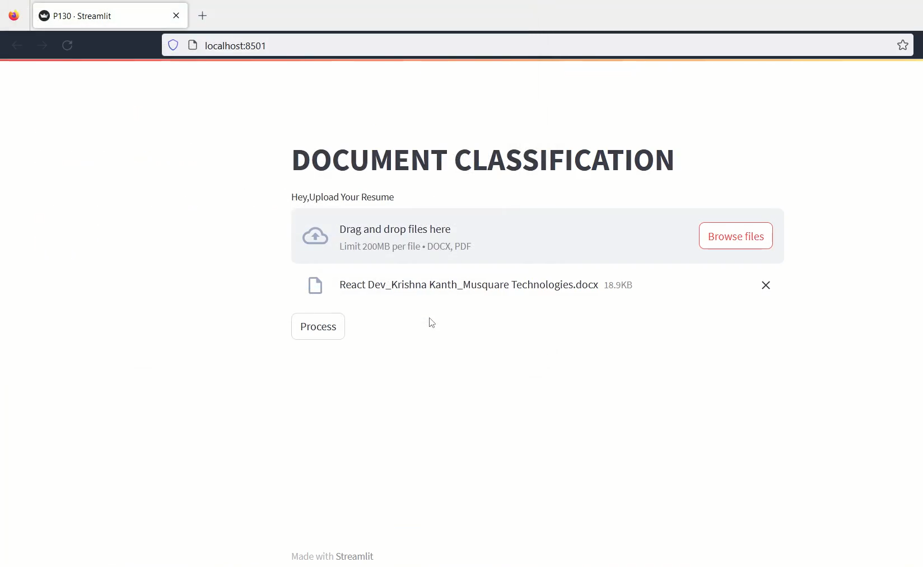
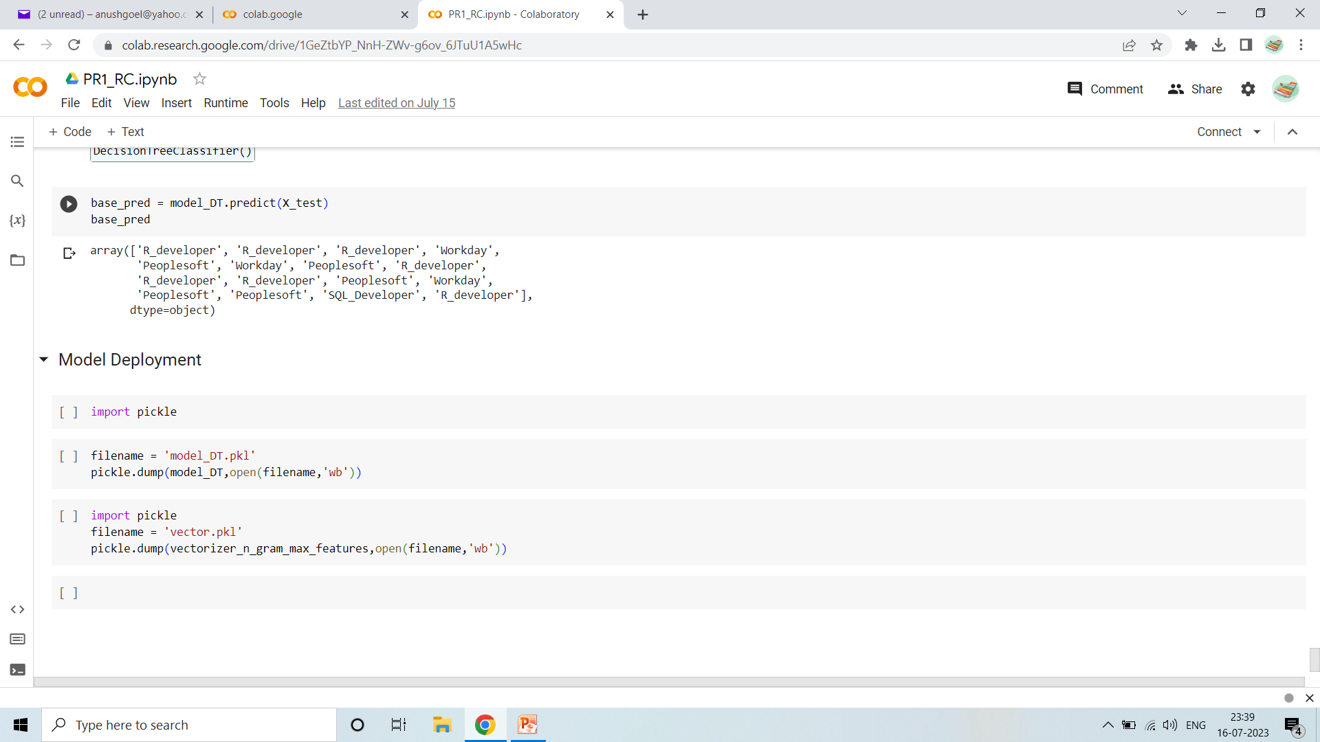
MODEL DEPLOYMENT

Slide 20
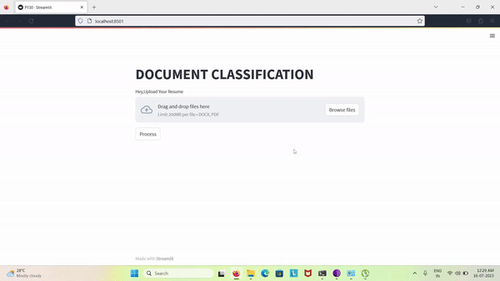

Slide 21
Conclusions
Model Performance: After fine-tuning different algorithms and approaches, our final model demonstrates impressive accuracy, precision, and recall rates, outperforming traditional rule-based methods.
Time Efficiency: The model's processing time is significantly faster compared to manual resume screening by human recruiters.
Adaptability: The developed model showcases a high level of adaptability to diverse resume formats, languages, and structures. This ensures its applicability in various recruitment scenarios and across industries.
Human Resource Empowerment: Instead of replacing human recruiters, the model serves as a valuable tool that enhances their efficiency and productivity. By filtering and categorizing resumes, recruiters can now allocate more time to conduct in-depth assessments of shortlisted candidates
Future Enhancements: While the model performs admirably, further improvements can be made by incorporating natural language processing advancements, leveraging larger and more diverse datasets, and exploring deep learning architectures.

